Slide 1

Atliq Hardware
Sales Analytics Report

Slide 2
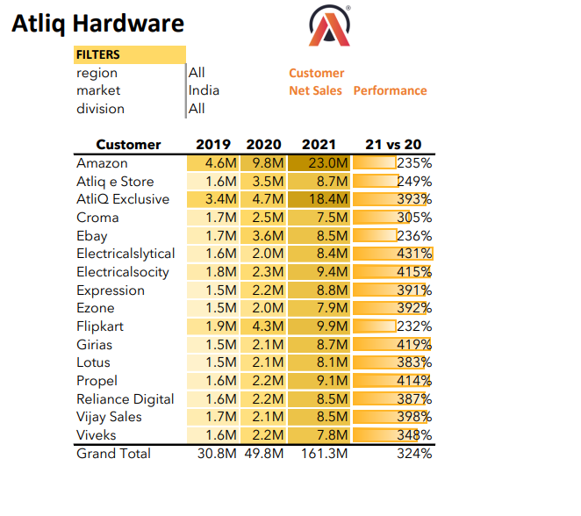
Customer Net Sales Performance in India
Atliq Hardware Customer Net Sales Performance in India in 2019,2020,2021

Slide 3
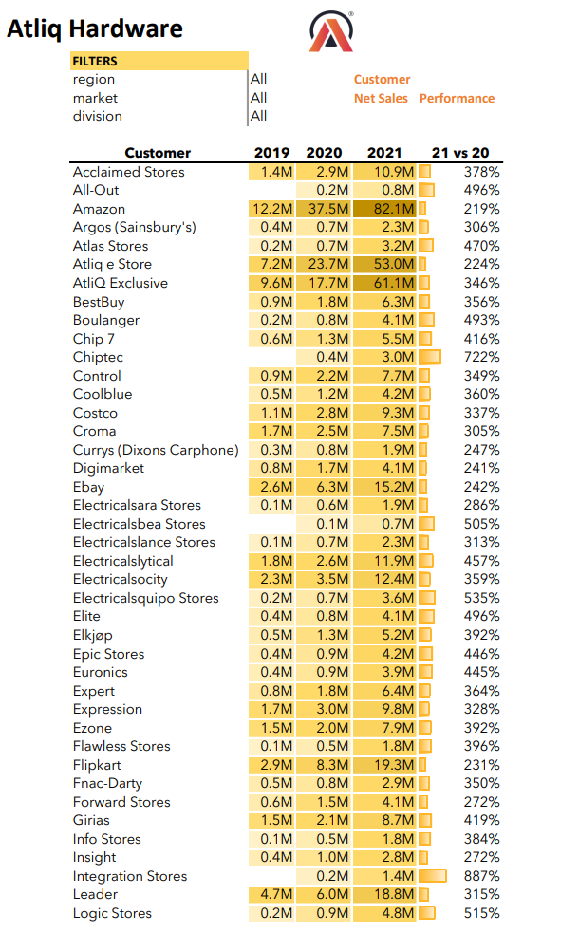
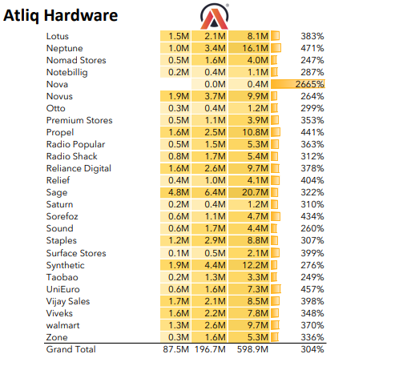
Overall Customer Net Sales Performance at Atliq Hardware
Atliq Hardware Overall Customer Net Sales Performance in 2019,2020,2021

Slide 4
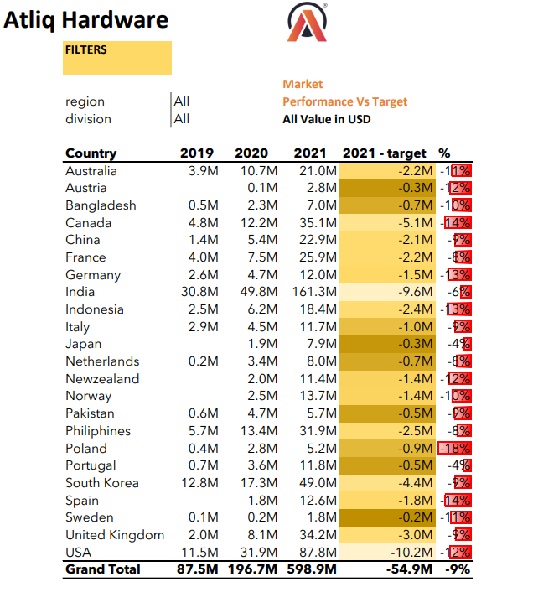
Market Performance Vs Targets

Slide 5
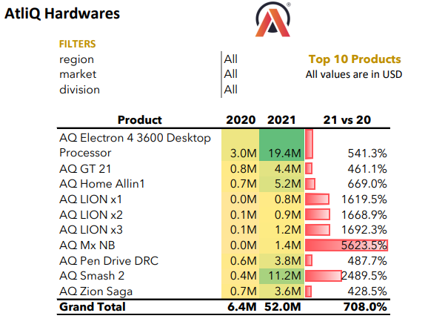
What are the top 10 products based on the percentage increase in their net sales from 2020 to 2021?

Slide 6
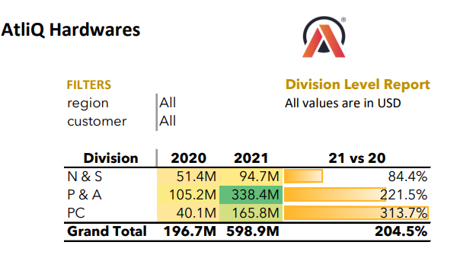
Generate a "Division" report to present the net sales data for 2020 and 2021, along with the growth percentage.

Slide 7
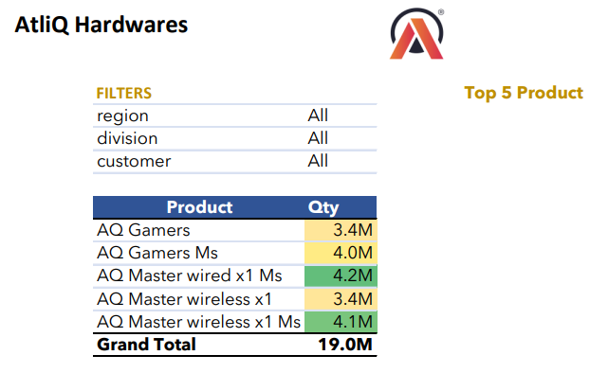
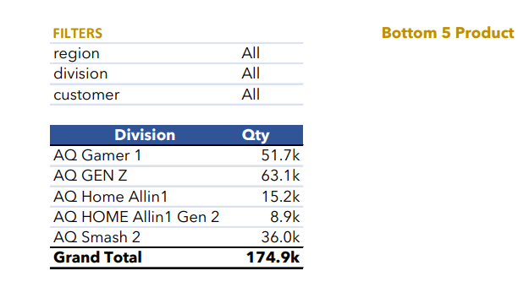
Which products are ranked in the top 5 and bottom 5 in terms of quantity sold?

Slide 8
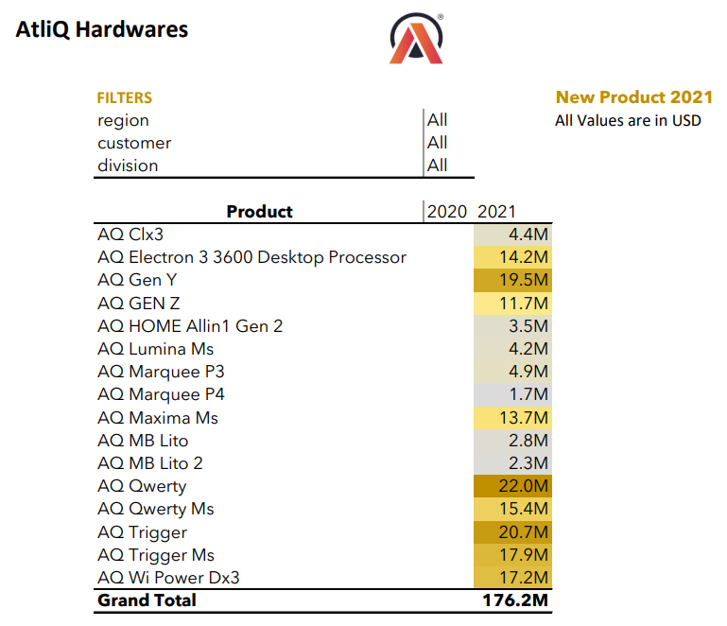
What are the new products that Atliq began selling in 2021?

Slide 9
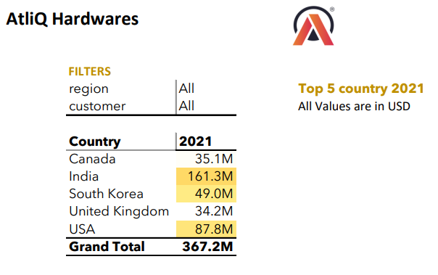
What are the top 5 countries in terms of net sales in 2021?

Slide 10
Thank You

